Slide 1
GROUP 2
RD Cleaning Group

Slide 2
GROUP 2
Abishek timsina(30375117)
Laman sharma
Dipesh Dhakal
Sudip thapaliya
Pratima Kc

Slide 3
Contents
Roles and responsibilities
User stories
Client detail
Project deliveries and goals
Product black log
i)Website overview
Sign up
Login
Main page
Reset password
Database

Slide 4
RD Cleaning Services
Westmead
• Window Cleaning & Blinds Cleaning & General Dusting
• Use Double disc scrubber for large strata, commercial and shopping complex.
• Mopping & Sweeping
• Pressure Cleaning carparks
• Carpet Cleaning & Tile Cleaning for commercial and shopping mall
• Bathroom – Shower, Toilet and Sink Cleaning, floor, alfresco for residential
• Gardening, lawn mowing & Watering plants all commercial, residential and strata complexes.
• Moving Bins to the street from within the complex for strata and commercial complex.
• Replacing blown globs commercial and Strata complex.

Slide 5
Website overview
Tools used:
My sql
Amp server
Notepad++
JavaScript
Html
Php
CSS
Dreamweaver

Slide 6
Users
- Site supervisor
- Cleaning Staff
- Customer
- Company Manager

Slide 7
Roles
Abishek Timsina (Product owner)
Dipesh Dhakal (Scrum master)
Laman sharma (Team member)
Sudip Tapaliya (Team member)
Pratima Kc (Team member)

Slide 8
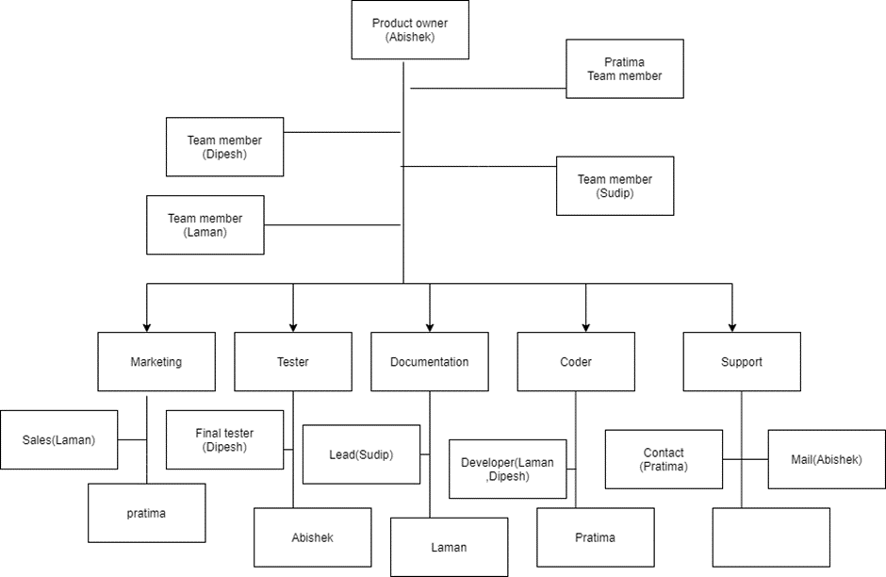
Responsibilities

Slide 9
Users story
Us 1 As a public user I want the sign up by entering my personal data ,so that I can access the cleaning services
Us 2 As a public user I want direct access to website for existing customer
Us 18 As a user ,I want a search bar where I can easily access to the thing that I need.
Us 22 As a user , I want the website to be simple so it will be easy for everyone.
Us 31 As a user, I want to online booking where it is easy for any user.

Slide 10
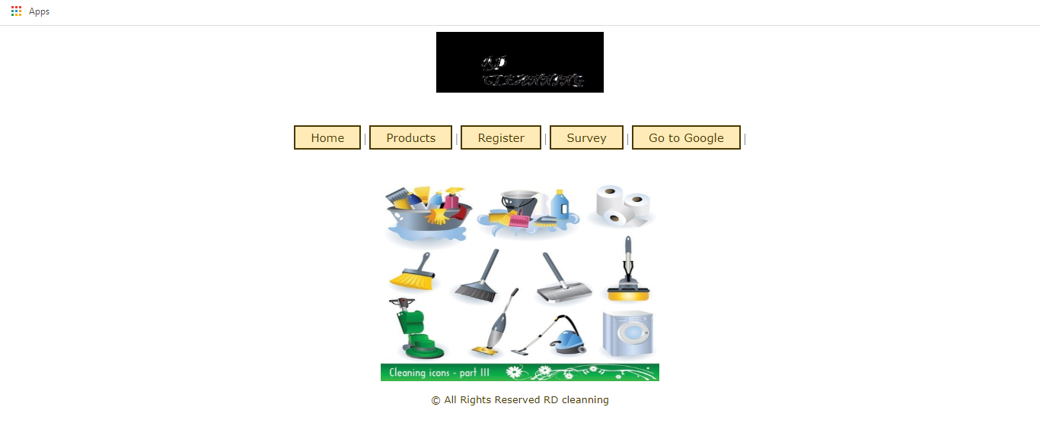
US 22

Slide 11
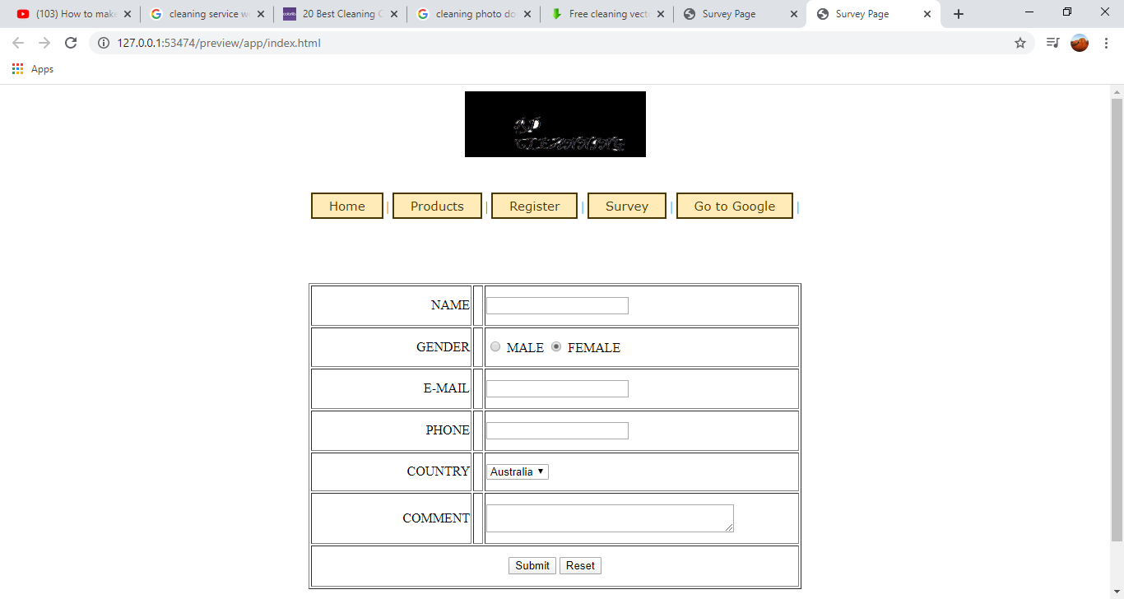
US 2

Slide 12
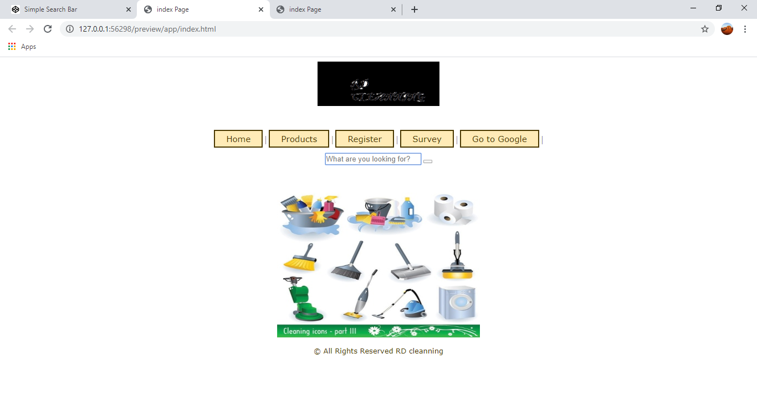
Us 18

Slide 13
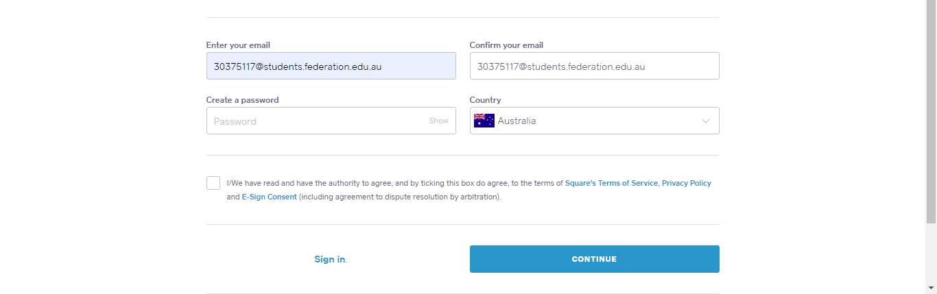
US 01

Slide 14
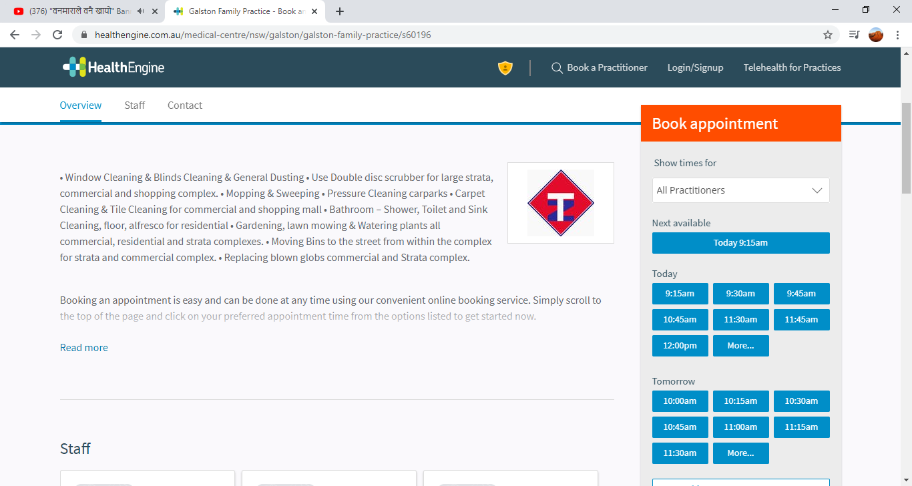
Us 31

Slide 15
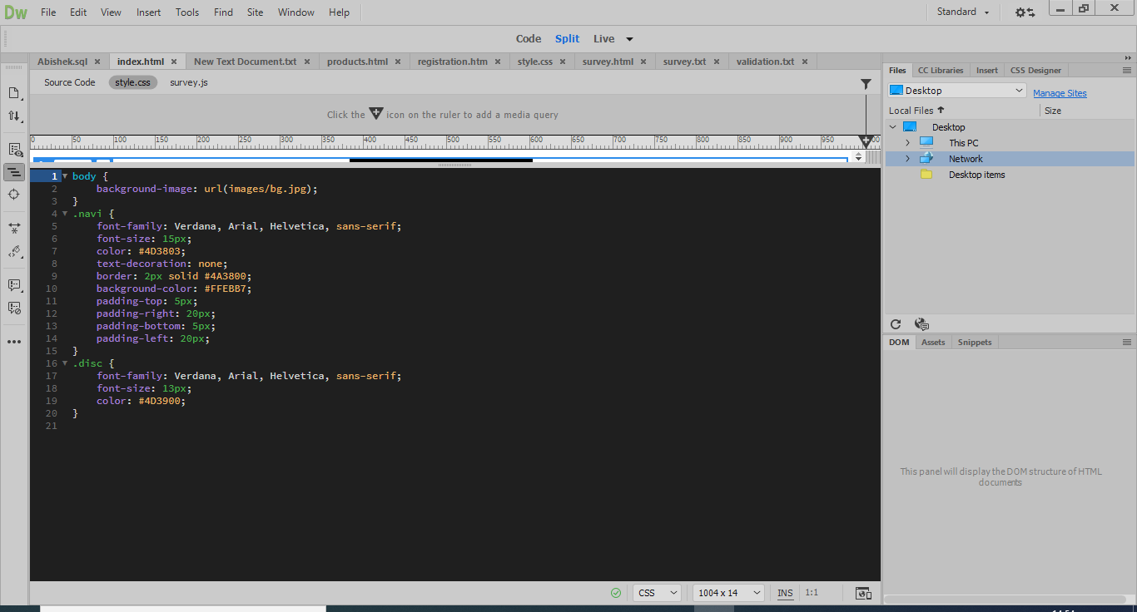
Code 1

Slide 16
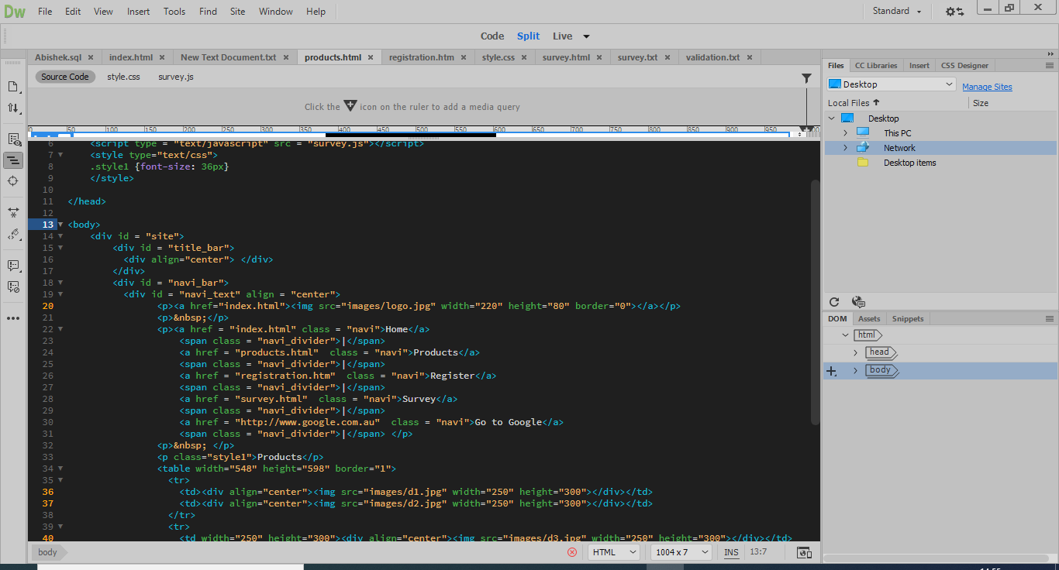
Code 2

Slide 17
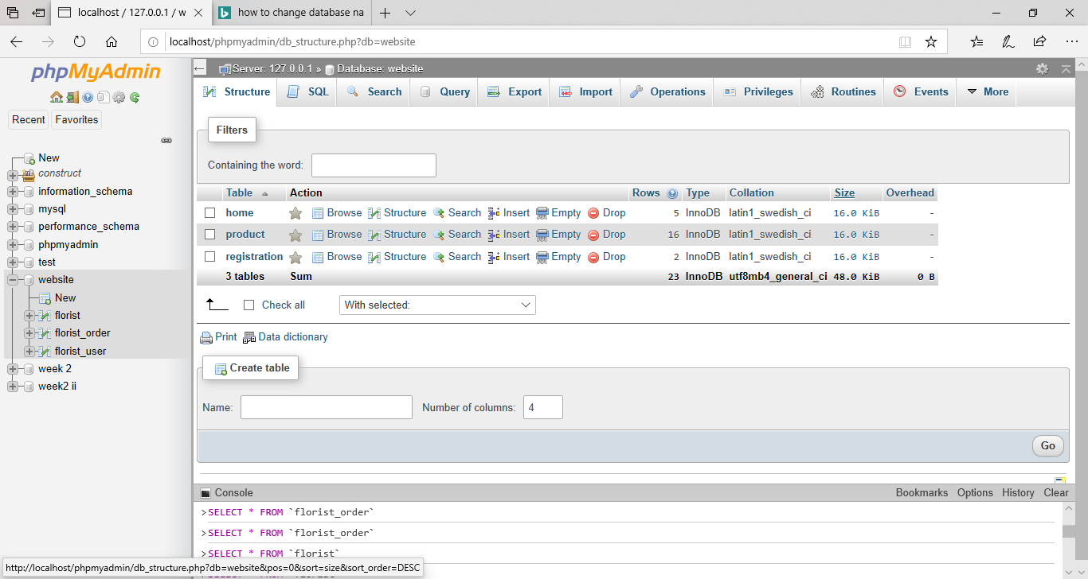
Database

Slide 18
Justification for choosing backlog items:
It would be easy for user to use the website
The website will be safe and secure for the users
Password is essential as no one can access the website without the password.
Login will be help as the user who need the service can access
the website

Slide 19
Reflection
What went well?
All the ideas were collected from all the team members about how to start the project.
All the tasks were divided equally among the group members.
All the members have contributed equally and completed all the task on time.
what is not in control?
All the team members cannot be available at the same time for the meeting which may cause delay the work.
Regular meetings may not be conducted.
There could be problem with the internet.

Slide 20
US 5 As a user I want to know about the company and its background
US 11 As user, I want to see or give feedback to the com-pany after buying the things from the shop.
US 7 As a user, I want to see the list of products avail-able in the store.
US 3 As a public user I want to know the charges done by the company.
US 9 As a user, I want to find out the trading hour of the company

Slide 21
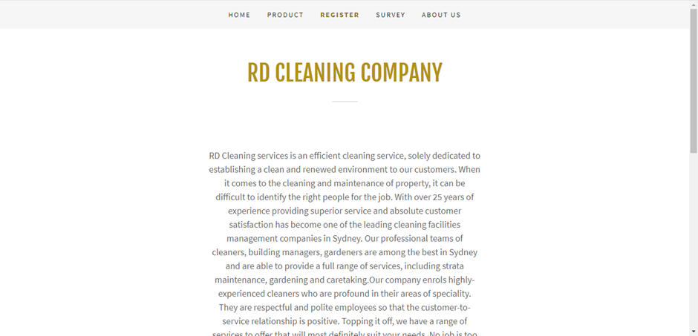
US 5

Slide 22
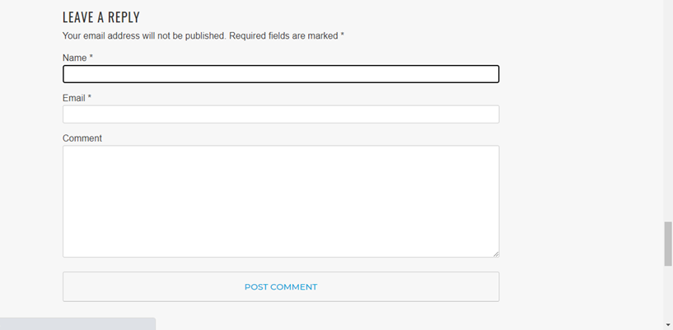
US 11

Slide 23
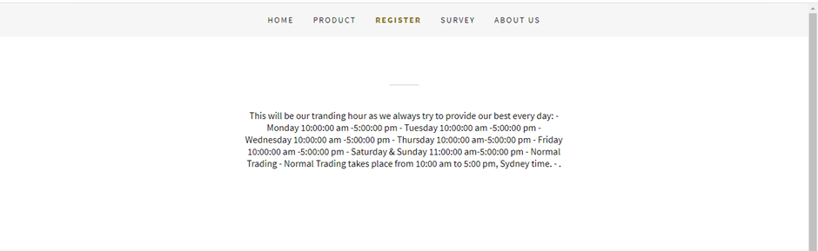
US 9

Slide 24
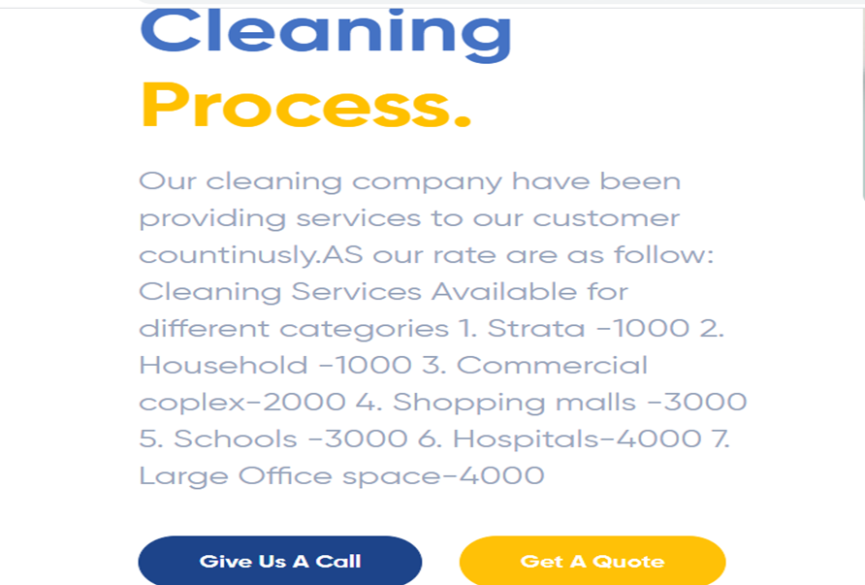
US 3

Slide 25
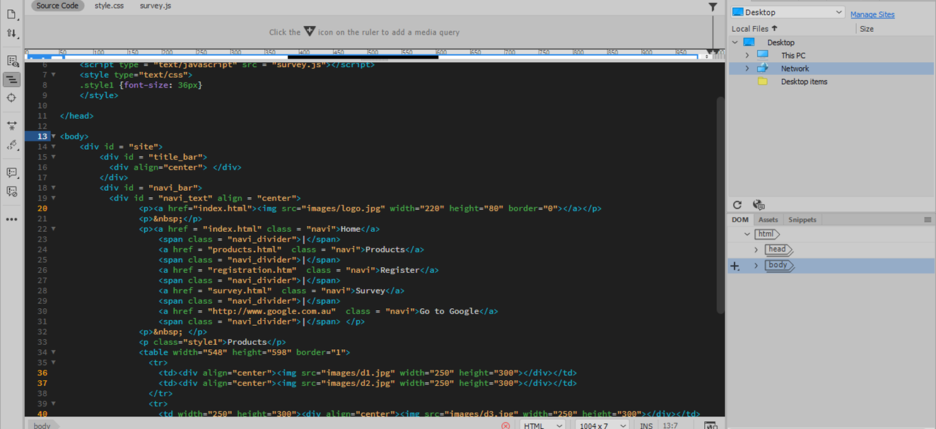
Code

Slide 26
Justification for choosing backlog items:
It would be easy for user to use the website
The website will be safe and secure for the users
It is compulsory that people know about the company background.
User need to know about the trending hour of the company.

Slide 27
Reference
https://github.com/Abishek-abi/Abishek.git

Slide 28
ANY QUESTION ?

